Slide 1
Crowd Funding Project Presentation

Slide 2
Objectives
DATA CLEANING AND VALIDATION
REVIEW PERFORMANCE METRICS
IDENTIFY TRENDS AND ANOMALIES
DASHBOARD CREATION (EXCEL, POWER BI, TABLEAU)
SQL QUERIES FOR KPIS.

Slide 3
Project Objective
This project aims to analyze the key factors that drive crowdfunding campaign success and understand performance across categories, locations, and time. This project provides exposure to data cleaning and validation, data importing to different visualization platforms, and analysing the dataset to find out the KPI’s. It focuses on uncovering insights to support crowdfunding operations and designing interactive dashboards and reports to highlight metrics and findings.

Slide 4
Data Transformation & Modelling:
Conversion of epoch dates to natural time.
Building a comprehensive calendar table to facilitate time-based analysis.
Currency conversion of goal amounts to USD.
Date range spanning from the minimum to maximum project creation dates.
Columns created: Year, Month number, Month full name, Quarter, Year-Month, Weekday, Financial Month, and Financial Quarter.

Slide 5
DATA CLEANING
Removing Duplicate Entries
Handling Missing Values
Deleted empty rows
Text Formatting and Standardization
Data Type Corrections

Slide 6
KPI’s and metrics Tracked:
Total number of projects by outcome (successful, failed, etc.)
Breakdown of projects by location and category.
Yearly, quarterly, and monthly project creation trends.
Amount raised for successful projects.
Number of backers for successful projects.
Average number of days to achieve success.
Top successful projects by the number of backers and by the amount raised.
Overall percentage of successful projects.
Success rates by category, year, month, and goal ranges.

Slide 7
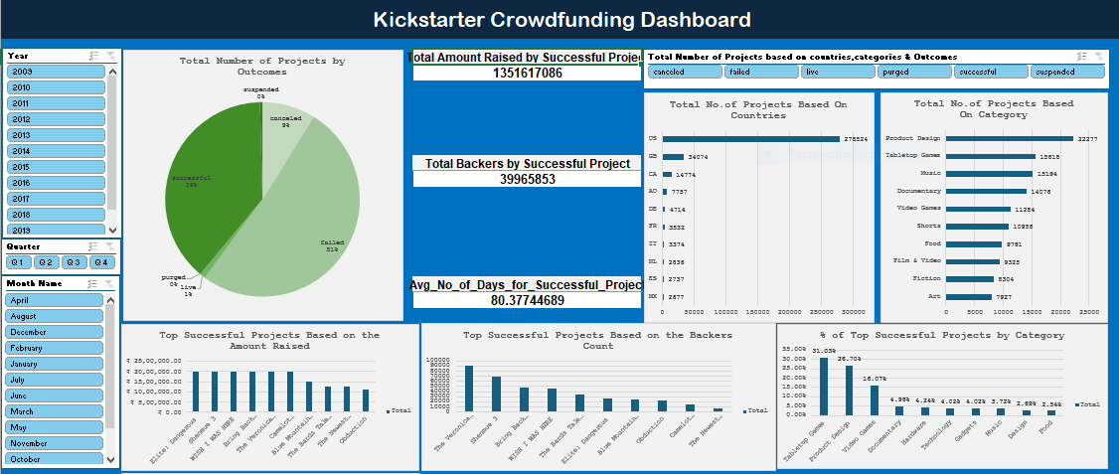
Excel Dashboard

Slide 8
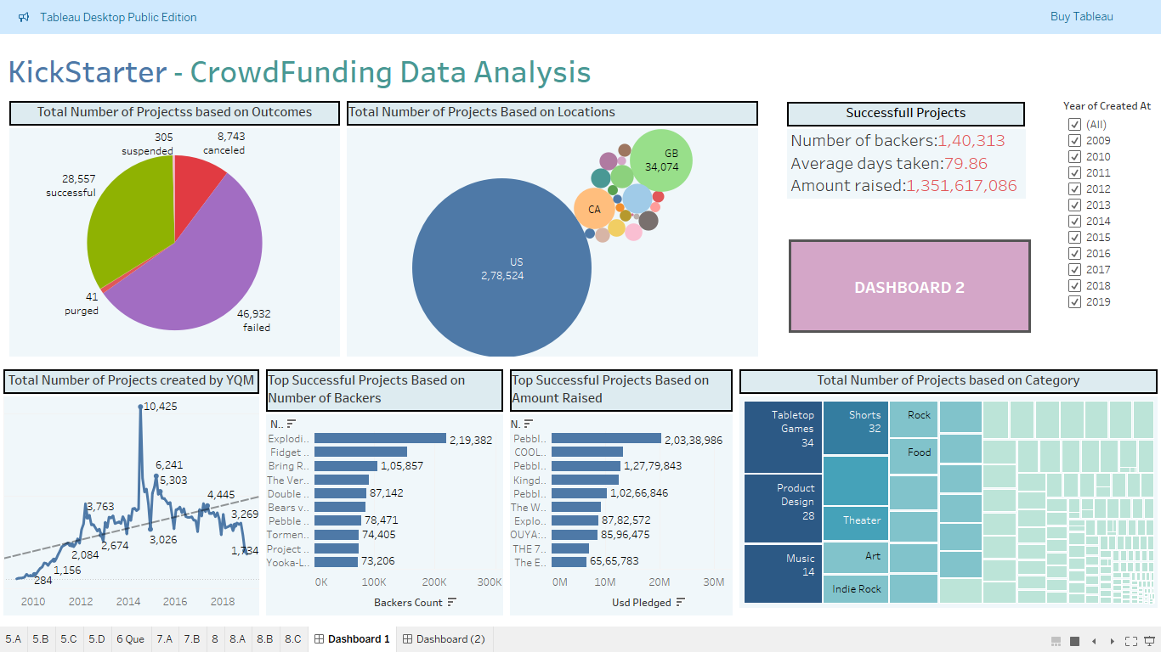
Tableau Dashboard

Slide 9
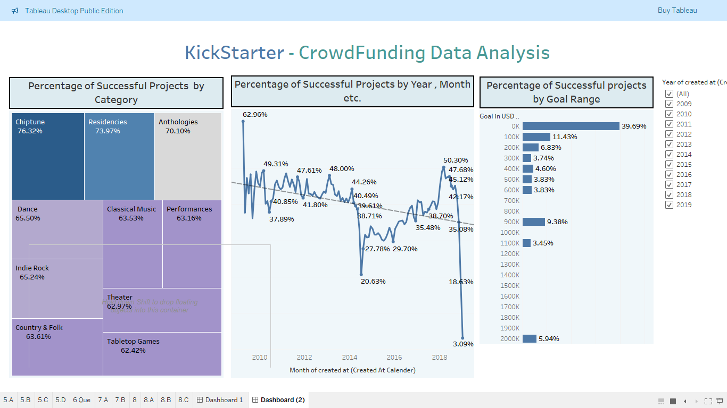
Tableau Dashboard

Slide 10
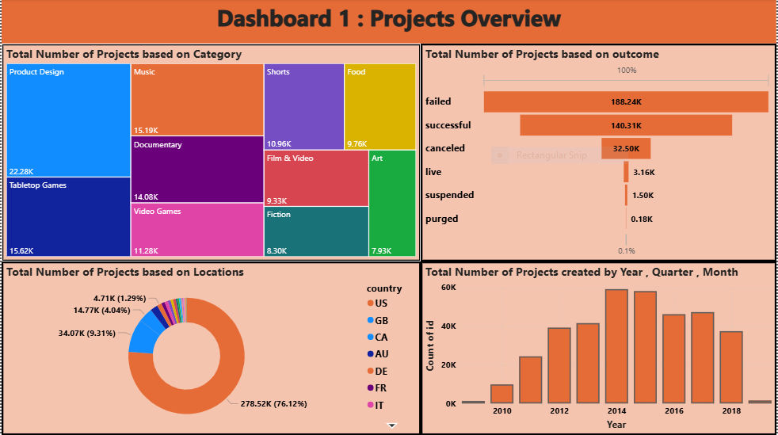
Power BI Dashboard

Slide 11
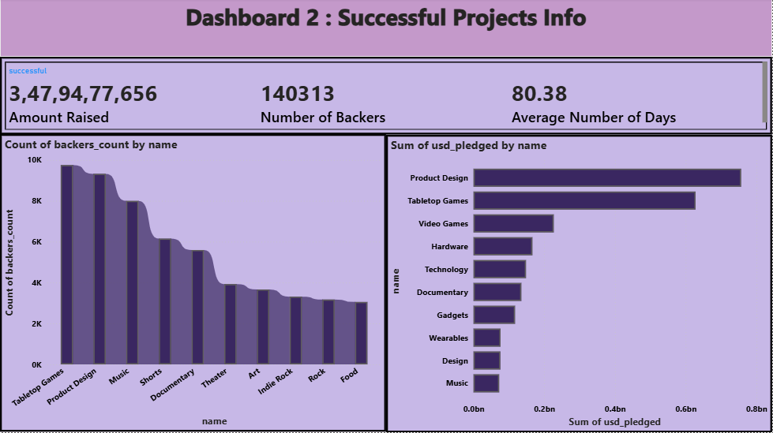

Slide 12
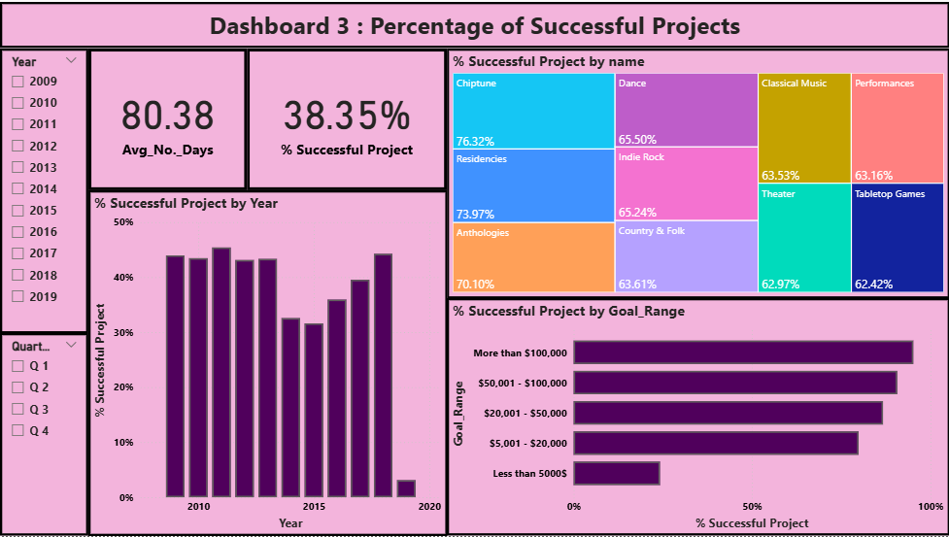

Slide 13
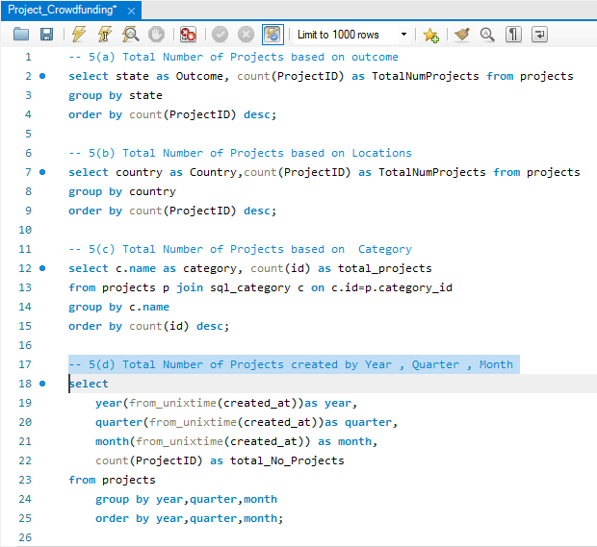
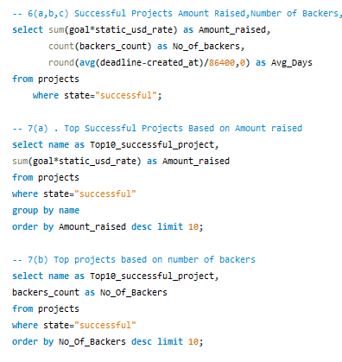
SQL Queries

Slide 14
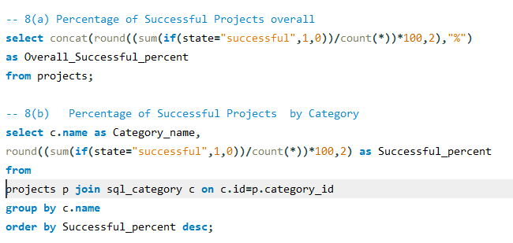
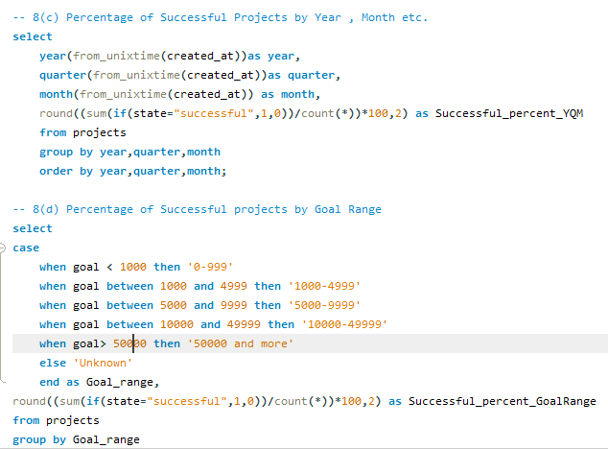
SQL QUERIES

Slide 15
CHALLENGES FACED AND POTENTIAL SOLUTIONS
While data cleaning in Power Query Editor we faced 72 name errors and replaced the errors with null values.
While visualization in Power BI, showing the highest value was a challenge. However, we resolved this challenge by applying DAX iterator function along with conditional formatting.
Importing large records table in SQL was bit challenging due to connectivity issues.

Slide 16
BUSINESS STRATEGIES AND RECOMMENDATIONS
Focus on Key Categories: It is observed that product categories like Product design, Video games, Technology stands on a top categories. That means, creator and backers should collaborate more and develop a strong marketing plan for their project.
Geographical Inclusion: It is observed that most of the projects are concentrated towards US region. Thus, there is a huge demand in penetrating to other countries like UK, Canada.
Improvement of Project Success Rate: Overall success rate is 38.35% with significant failing project. Thus, collaboration with backers and creators should be strong enough to provide basic resources like workshops, templates and effective training for creators to prepare their campaigning plans.
Address Peak times: Peak in project creation and success occurs at a specific months and quarters. Thus, we should run promotional events at high traffic time to scale up the funding activity and enhance platform engagements.
Backers Retention: Although we observe that 45 million backer are engaged with the projects, retention of the backers are the major aspect to project completion. Creation of loyalty programs, access to premium project and frequent communication with the top backers will help achieve backers retention.

Slide 17
THANKYOU

